Slide 1
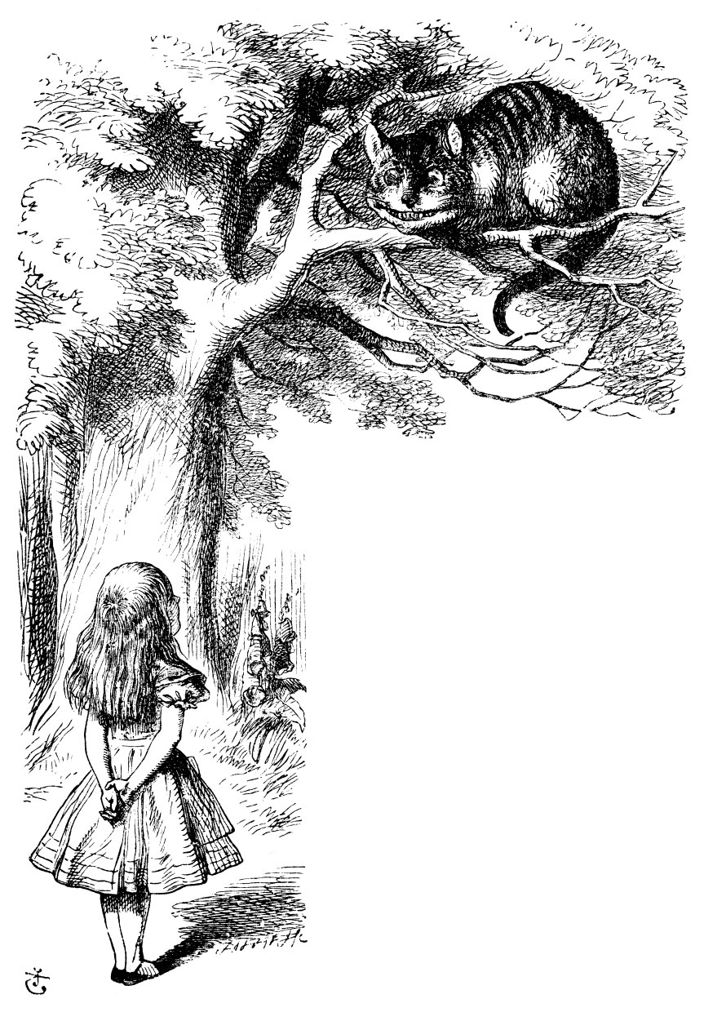
Alice will take you with her into the wonderland of imagination.

Slide 2
You will be witness of an unusual communication,

Slide 3
...participate in this communication,

Slide 4
...in a wonderland communication.

Slide 5
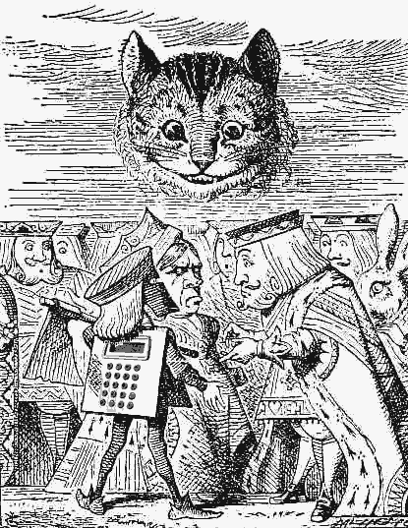
You will need a calculator.

Slide 6
Have you got the calculator?
Good
< click

Slide 7
This is the Cheshire cat. You will see that she knows your thoughts.

Slide 8
Choose a number from 1 to 70.
< click

Slide 9
Look the cat in the eyes and then
visualise your number within the red circle.
< click

Slide 10
Divide the number by 7 using the calculator,
add up the first 6 digits after the decimal point.
(if there are no digits after the decimal point, divide the answer by 7 again)
to this sum you now add the wonderland number 64.
< click

Slide 11
Now the cat from Wonderland will communicate with you, will guess the number that you just have calculated.
Although it neither knows you, nor sees you.
< click

Slide 12
In your case the cat sees a very special number...
91.
It sees a page...
Page 91.
< click

Slide 13
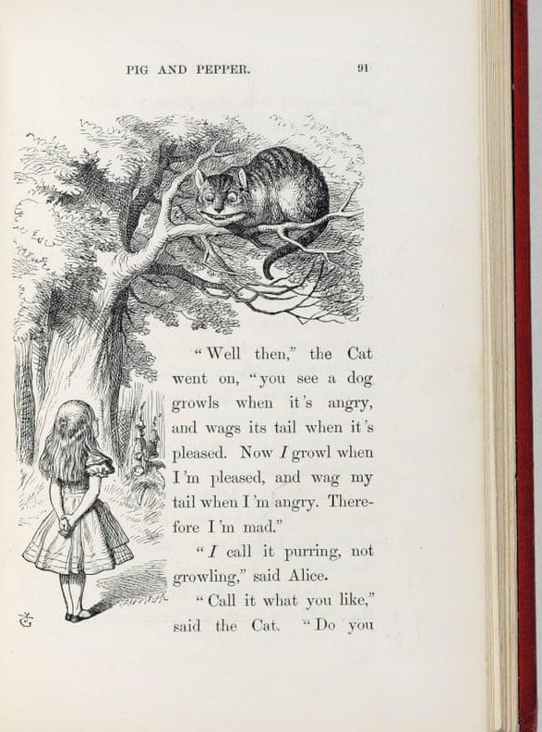
See you soon in Wonderland.
Please read from page 91 in our text.

